Slide 1

Go, change the world
RV College of
Engineering
Approximate Multiplier Design Using Novel Dual-Stage 4 : 2 Compressors
Advanced Digital System Design using Verilog HDL
NAME: RAJAT RAJ USN: 1RV19EC195

Slide 2

Go, change the world
RV College of
Engineering
Domain: VLSI
Technology: Low Power
The power consumption and speed are critical parameters in the design of digital circuits.
Very often, the optimization of one parameter is performed considering a constraint for the other parameter. Specifically, achieving the desired performance (speed) considering the limited power budget of portable systems is challenging task.

Slide 3
Go, change the world
RV College of
Engineering
This project explores and proposes the design and analysis of two approximate compressors with reduced area, delay and power with comparable accuracy when compared with the existing architectures.

Slide 4
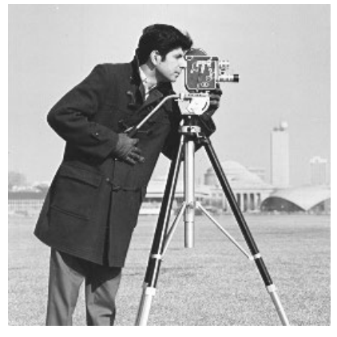
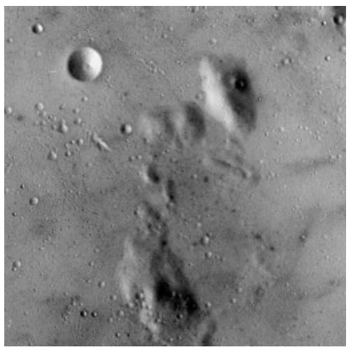
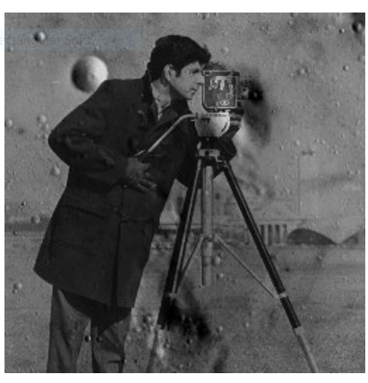
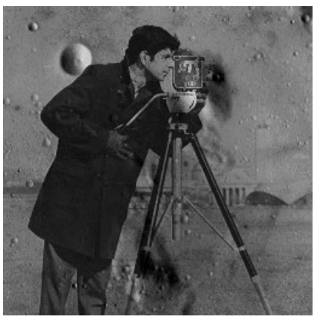
Go, change the world
RV College of
Engineering
Cameraman
Moon Surface
X
Result from Exact Multiplication
Result from Approximate Multiplication

Slide 5
Go, change the world
RV College of
Engineering
EXISTING METHOD
ARITHMETIC CIRCUIT
The multiplier is one of the main blocks, which is widely used in different applications especially signal processing applications
MULTIPLIER
SEQUENTIAL
PARALLEL
(low power, their latency is very large)
(such as Wallace tree and Dadda) are fast while having high-power consumptions.

Slide 6
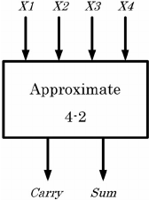
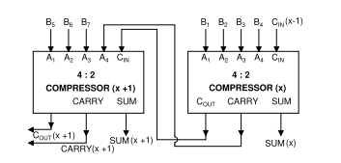
Go, change the world
RV College of
Engineering
To reduce the delay of the partial product summation stage of parallel multipliers, 4:2 and 5:2 compressors are widely employed.
Compressor chain

Slide 7
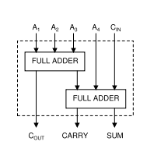
Go, change the world
RV College of
Engineering
The general structure of an exact 4 : 2 compressor is shown in Figure .
It comprises of five inputs, three outputs and two cascaded full adders. A1, A2, A3, A4 and CIN are the inputs and COUT , CARRY and SUM are the outputs of the exact 4:2 compressor.
COUT , CARRY and SUM are given as
COUT = A3(A1 ⊕ A2) + A1(A1 ⊕ A2)
CARRY = CIN (A1 ⊕ A2 ⊕ A3 ⊕ A4) +A4(A1 ⊕ A2 ⊕ A3 ⊕ A4)
SUM = CIN ⊕ A1 ⊕ A2 ⊕ A3 ⊕ A4 (3)
Structure of the conventional exact 4:2
compressor

Slide 8
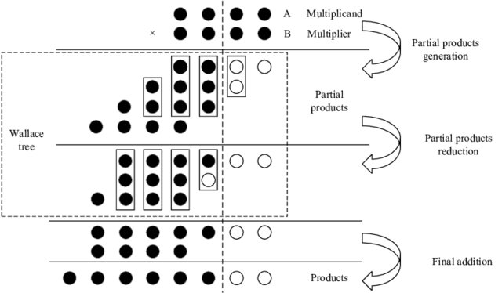
Go, change the world
RV College of
Engineering
Multiplication involves mainly 3 steps
Partial product generation
Partial product reduction
Final addition

Slide 9
Go, change the world
RV College of
Engineering
Disadvantages
Power consumption is more .
Area efficiency is less.

Slide 10
Go, change the world
RV College of
Engineering
Proposed Method
A novel high speed area-efﬁcient 4 : 2 compressor.
A modiﬁed dual-stage compressor.

Slide 11
Go, change the world
RV College of
Engineering
The proposed high speed area-efﬁcient 4 : 2 approximate compressor is shown in Figure on next slide.
The compressor inputs are A1, A2, A3 and A4, outputs are CARRY and SUM. A multiplexer (MUX) based design approach is used to generate SUM. Output of XOR gate acts as the select line for the MUX. When select line goes high, (A3A4) is selected and when it goes low, (A3+A4) is selected.

Slide 12
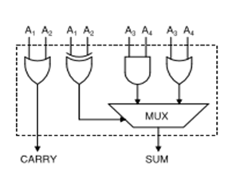
Go, change the world
RV College of
Engineering
The logical expressions for realization of SUM and CARRY are given below.
SUM = (A1⊕A2)A3A4+(A1⊕A2)(A3+A4)
CARRY = A1+A2

Slide 13
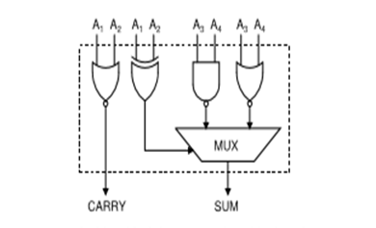
Go, change the world
RV College of
Engineering
In the high speed area-efﬁcient compressor architecture ,apart from the MUX, one XOR, one AND and two OR gates are required. OR and AND gates each need 6 transistors in CMOS logic implementation.
In order to reduce the transistor count, architecture with NAND and NOR gates are used as shown in Figure.

Slide 14
Go, change the world
RV College of
Engineering
Approximation is done by eliminating Cout and Cin.
Error has been introduced for the input values − {0011}, {0100}, {1000} and {1111}, so as to ensure that equal positive and negative deviation with ED = 1 (minimum) is obtained.
ED(Error Dist.) refers to the difference between the exact 4 : 2 compressor output and the approximate 4 : 2 compressor output.

Slide 15
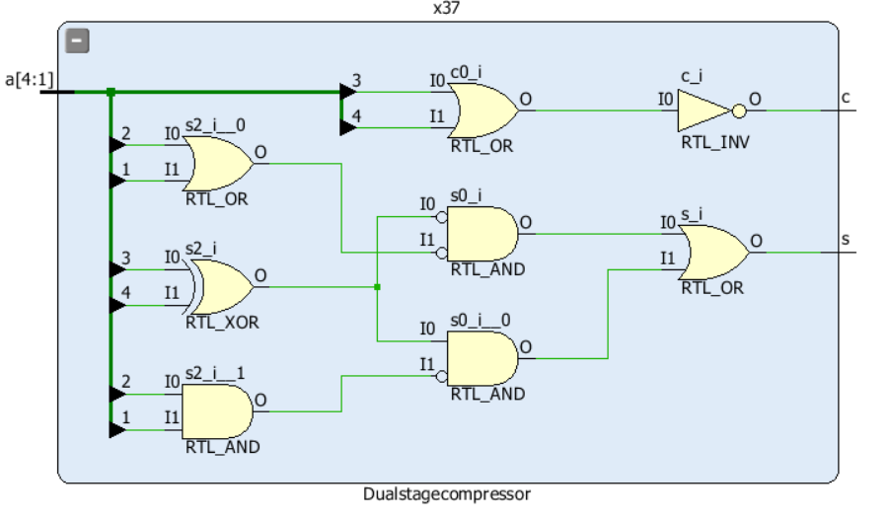
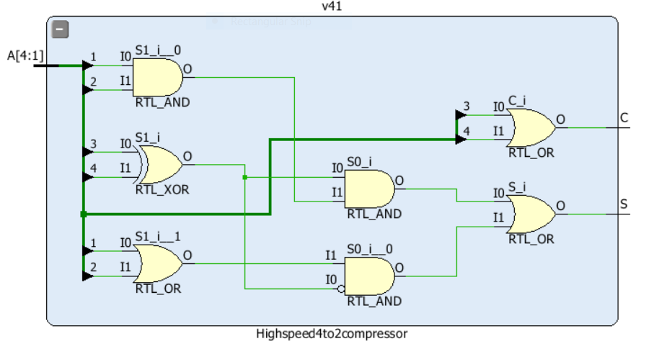
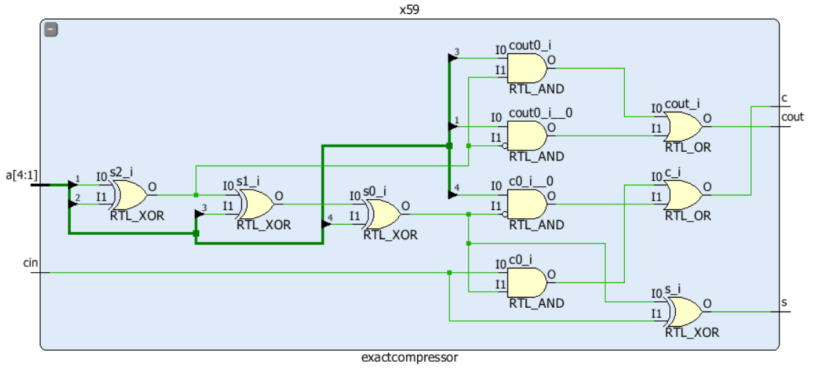
9 Cells, 12 Nets
8 Cells, 11 Nets
11 Cells, 15 Nets

Slide 16
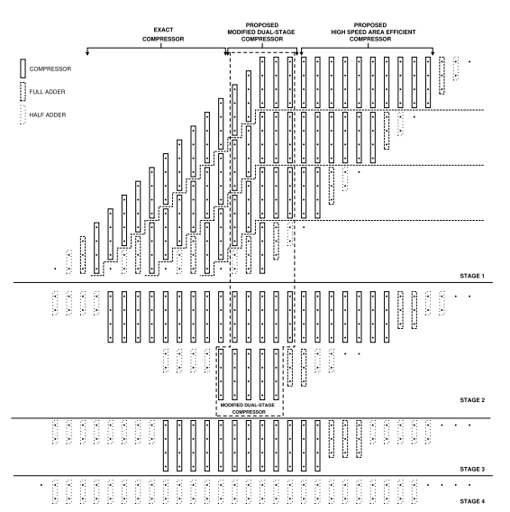
Go, change the world
RV College of
Engineering

Slide 17
Go, change the world
RV College of
Engineering
EXISTING METHODOLOGY

Slide 18
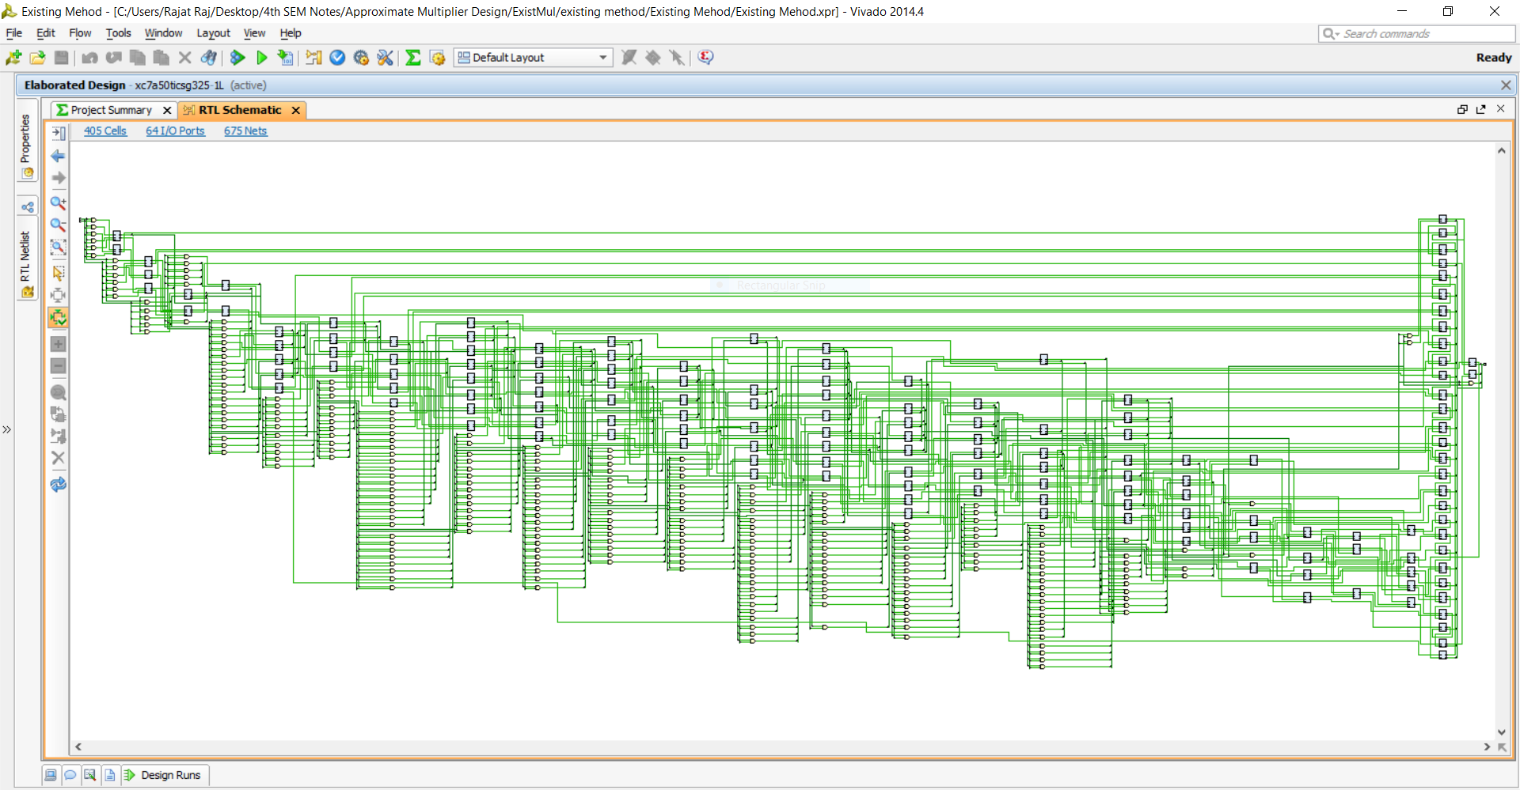
Go, change the world

Slide 19
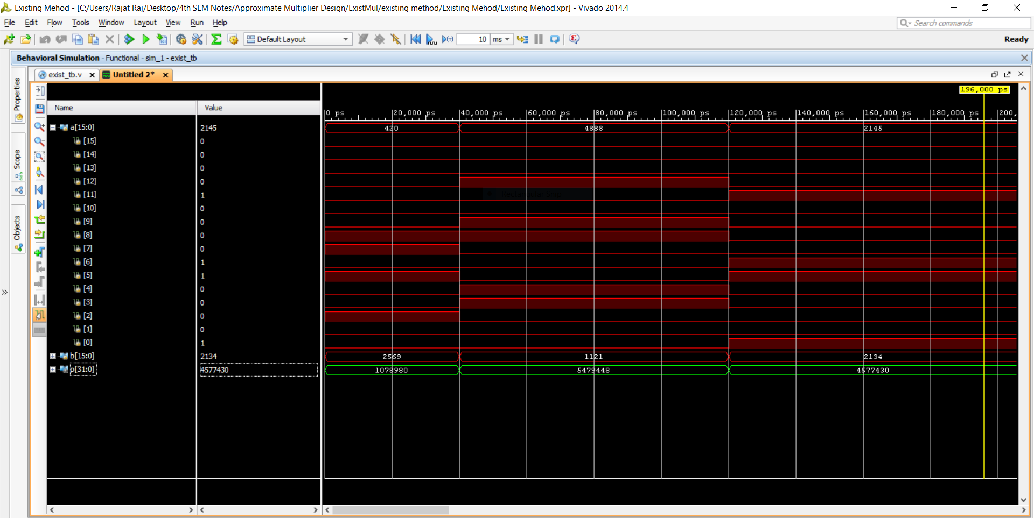

Slide 20
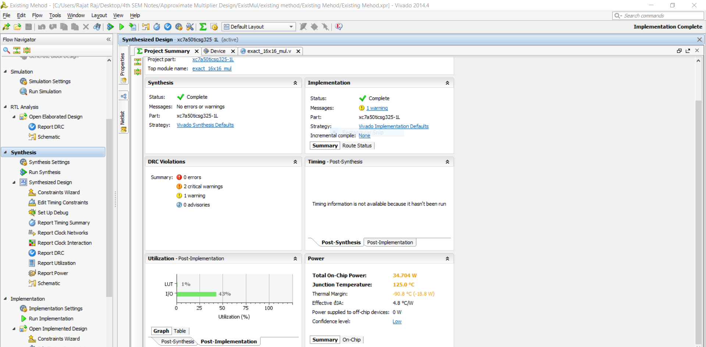
Go, change the world
RV College of
Engineering

Slide 21
Go, change the world
RV College of
Engineering
PROPOSED METHODOLOGY

Slide 22
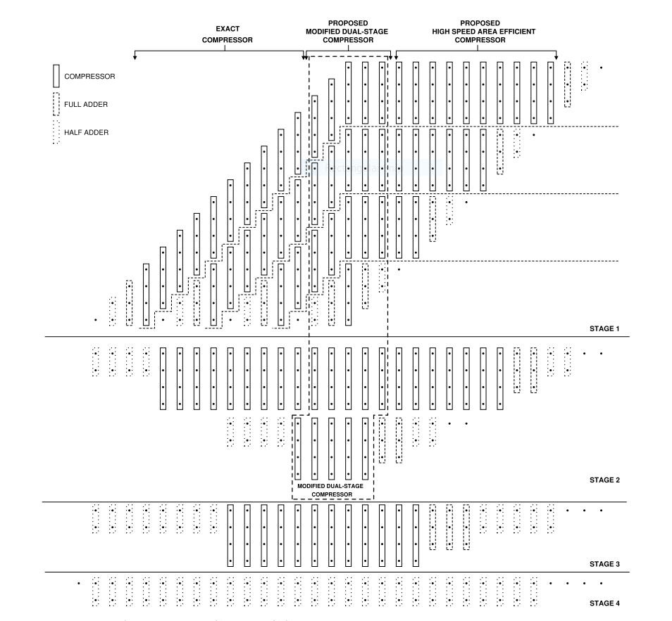
Go, change the world
RV College of
Engineering
Proposed 4 : 2 compressors used in 16 × 16 multiplier.

Slide 23
Go, change the world
RV College of
Engineering
CODE
16bitmultiplerdesign_code_with_testbench

Slide 24
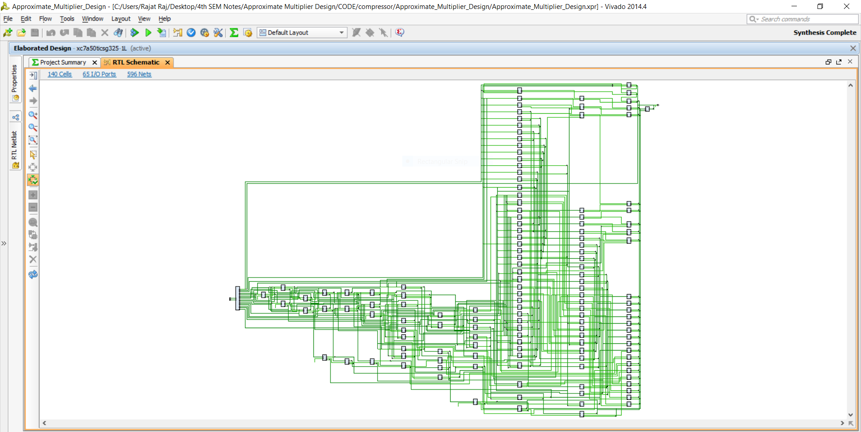

Slide 25
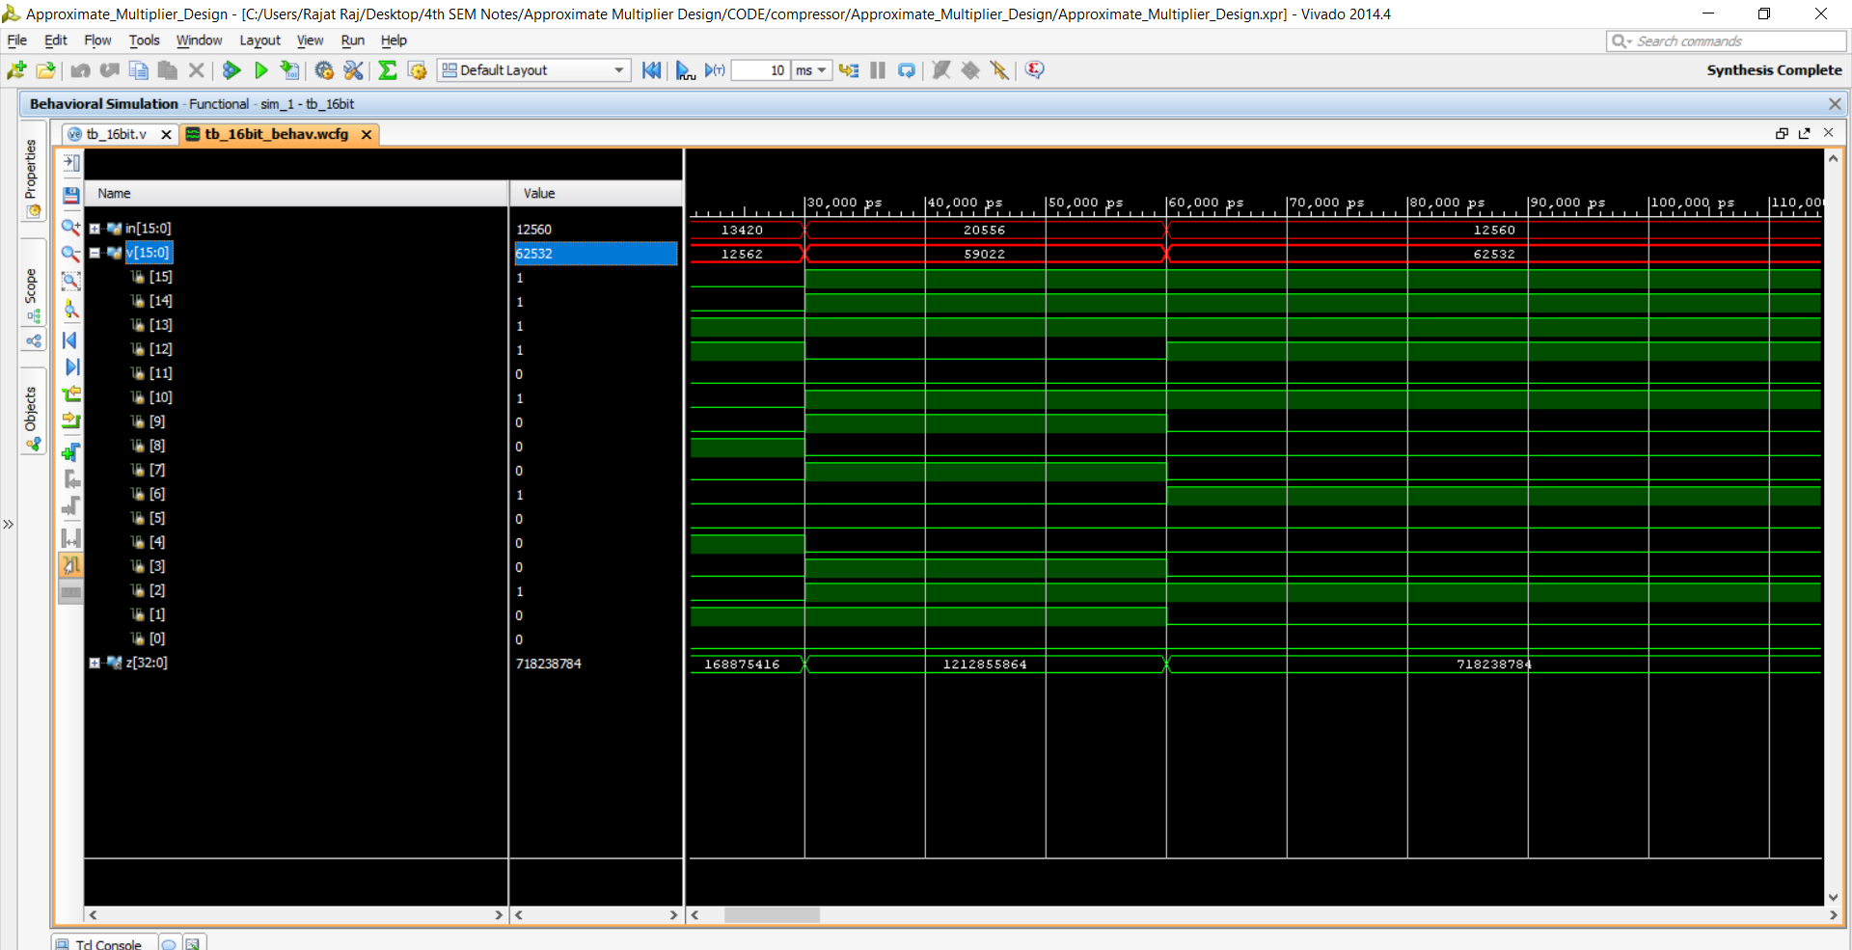
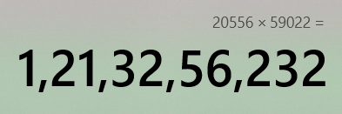

Slide 26
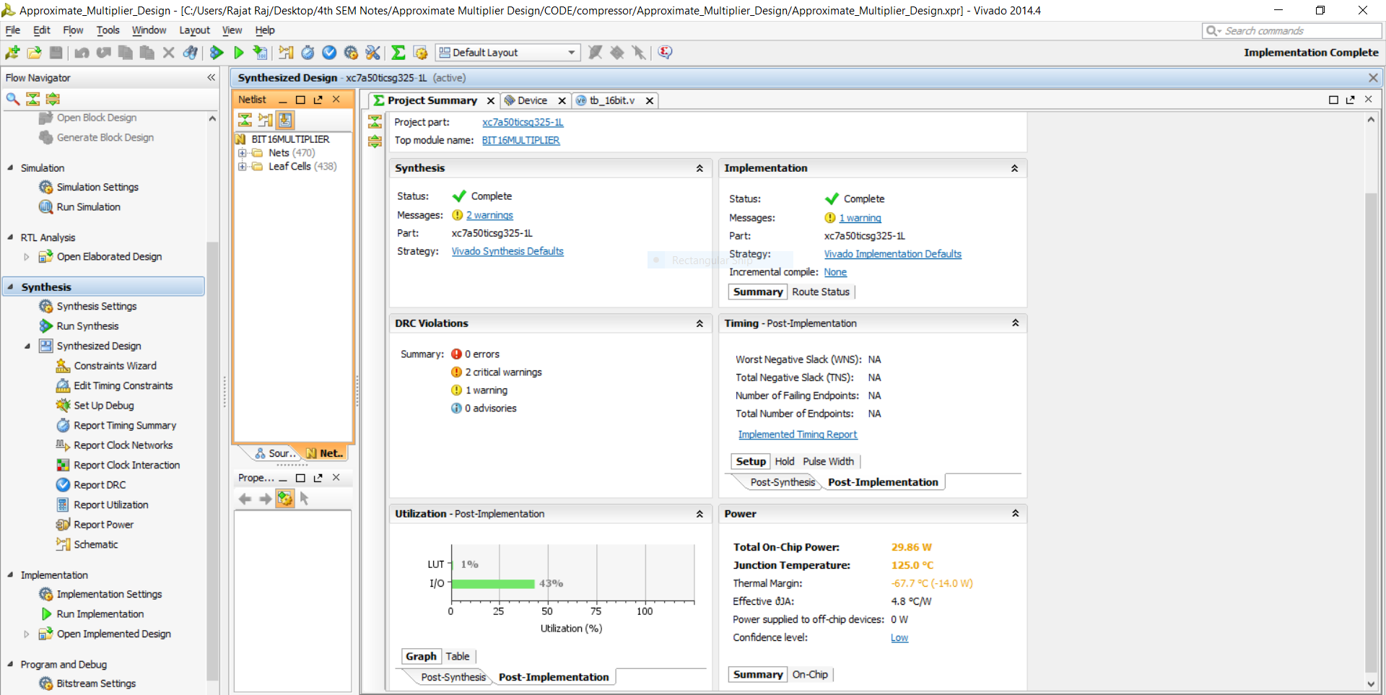
Go, change the world
RV College of
Engineering

Slide 27
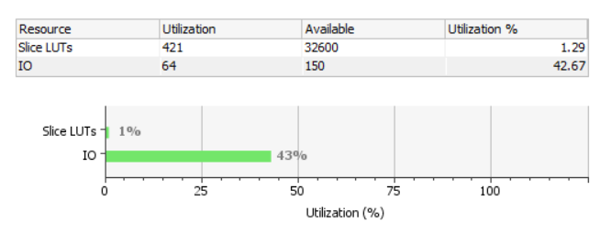
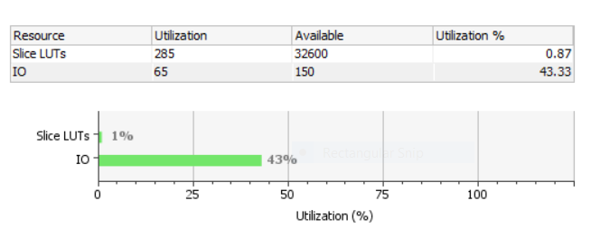
Go, change the world
COMPARISON between Existing and Proposed
RV College of
Engineering
Area Utilization Report
Existing Model for 16bitmul
Proposed Model for 16bitmul

Slide 28
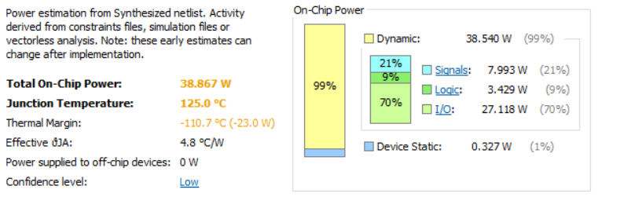
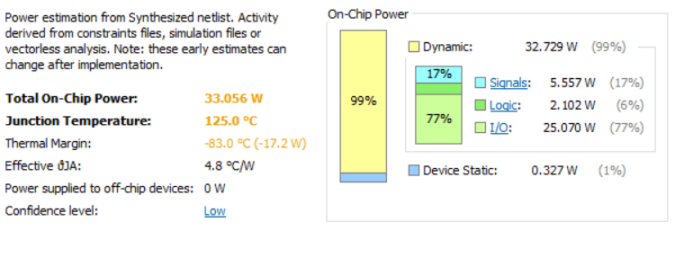
Go, change the world
COMPARISON between Existing and Proposed
RV College of
Engineering
Power Report
Existing Model for 16bitmul
Proposed Model for 16bitmul
Proposed Model for 16bitmul

Slide 29
Go, change the world
COMPARISON between Existing and Proposed
RV College of
Engineering
Timing Report
Max Delay Paths
--------------------------------------------------------------------------------------
Slack: inf
Source: a[1]
(input port)
Destination: p[30]
(output port)
Path Group: (none)
Path Type: Max at Slow Process Corner
Data Path Delay: 17.185ns (logic 6.876ns (40.009%) route 10.310ns (59.991%))
Logic Levels: 18 (IBUF=1 LUT3=2 LUT4=3 LUT5=6 LUT6=5 OBUF=1)
Existing Model for 16bitmul
Min Delay Paths
--------------------------------------------------------------------------------------
Slack: inf
Source: a[0]
(input port)
Destination: p[0]
(output port)
Path Group: (none)
Path Type: Min at Fast Process Corner
Data Path Delay: 1.974ns (logic 1.299ns (65.832%) route 0.674ns (34.168%))
Logic Levels: 3 (IBUF=1 LUT2=1 OBUF=1)

Slide 30
Go, change the world
COMPARISON between Existing and Proposed
RV College of
Engineering
Timing Report
Max Delay Paths
--------------------------------------------------------------------------------------
Slack: inf
Source: in[4]
(input port)
Destination: z[31]
(output port)
Path Group: (none)
Path Type: Max at Slow Process Corner
Data Path Delay: 15.417ns (logic 5.886ns (38.176%) route 9.532ns (61.824%))
Logic Levels: 18 (IBUF=1 LUT4=3 LUT5=1 LUT6=12 OBUF=1)
Proposed Model for 16bitmul
Min Delay Paths
--------------------------------------------------------------------------------------
Slack: inf
Source: v[0]
(input port)
Destination: z[0]
(output port)
Path Group: (none)
Path Type: Min at Fast Process Corner
Data Path Delay: 1.974ns (logic 1.299ns (65.832%) route 0.674ns (34.168%))
Logic Levels: 3 (IBUF=1 LUT2=1 OBUF=1)

Slide 31
Go, change the world
RV College of
Engineering
REFERENCES
M. Ha and S. Lee, ‘‘Multipliers with approximate 4–2 compressors and error recovery modules,’’ IEEE Embedded Syst. Lett., vol. 10, no. 1, pp. 6–9, Mar. 2018.
Approximate Multiplier Design Using Novel Dual-Stage 4 : 2 Compressors Pranose J. Edavoor. Sithara Ravenraan, and Amol D. Rahulkar ,IEEE, Mar 2020
H. Jiang, C. Liu, L. Liu, F. Lombardi, and J. Han, ‘‘A review classification and comparative evaluation of approximate arithmetic circuits,’’ ACM J. Emerg. Tech. Comput. Syst., vol. 13, no. 4, p. 60, 2017
I. Alouani, H. Ahangari, O. Ozturk and S. Niar, “A Novel Heterogeneous Approximate Multiplier for Low Power and High Performance”, IEEE Embedded Syst. Lett., vol. 10, no. 2, June 2018, pp. 45-48

